Slide 1
Welcome to Colorlab!
University of Arizona, ratcliff group

Slide 2

Downloading Anaconda
The Colorlab GUI is a python based application. The easiest way to setup your environment is by downloading Anaconda which will automatically install the required packages that the Colorlab GUI requires
Download Anaconda here: https://docs.anaconda.com/anaconda/install/windows/

Slide 3
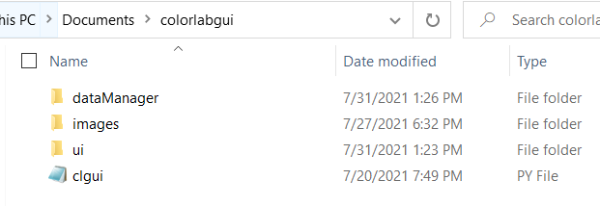
Getting started with Colorlab GUI
When you download Colorlab GUI, it will consist of three subdirectories and one python script at the main level
The dataManager folder contains the source code that is used to convert UV-Vis data to the RGB scale and produce the image
The images folder is where the images are saved when running Colorlab GUI
The ui folder contains the source code that is used to build the GUI

Slide 4
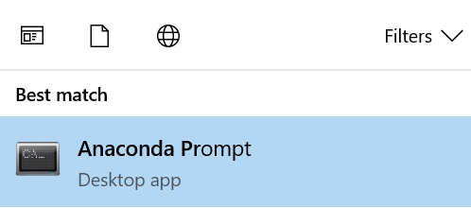
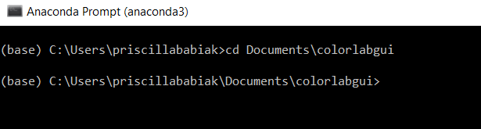


Running Colorlab
The easiest way to run Colorlab is through the Anaconda Prompt. To open this, search “Anaconda” in the Windows search box and select Anaconda Prompt.
Next, navigate to the top level of the colorlabgui folder

Slide 5
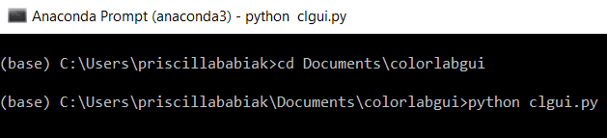
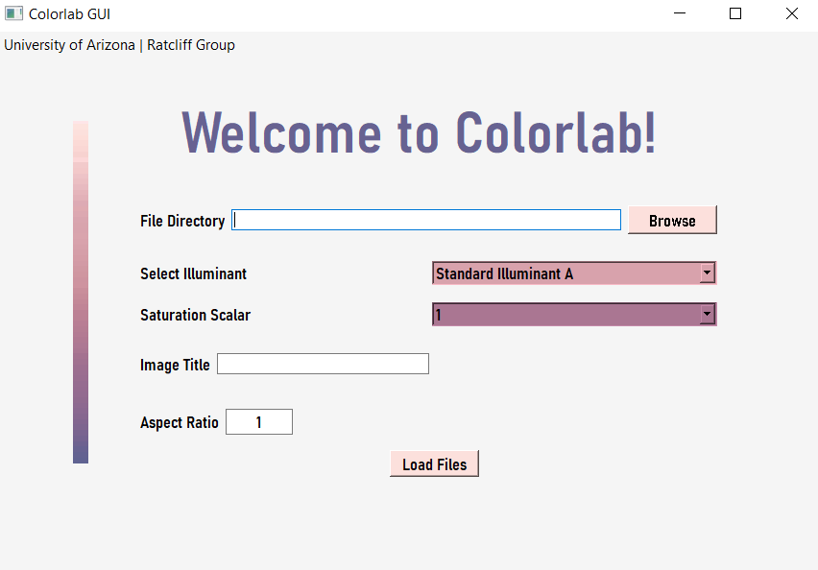
Running Colorlab
Once you have navigated to the colorlabgui folder, you can run the GUI by typing the following command: python clgui.py
After executing this command, the Colorlab GUI window should appear. Hurray!

Slide 6
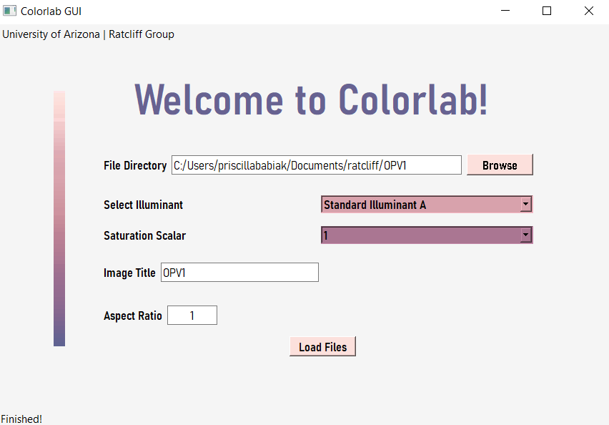
Running Colorlab
Point to the location where the UV-Vis data lives
Select from: Illuminant A, Illuminant C, Illuminant D65, Illuminant D50, Illuminant D55, Illuminant D75
You have the option to scale the data which can saturate the final image differently
Add a title to your image
Control image aspect ratio
Hitting “load files” kicks off the program to generate the images
If the program was successful in generating the image, you will see the message “Finished!”

Slide 7
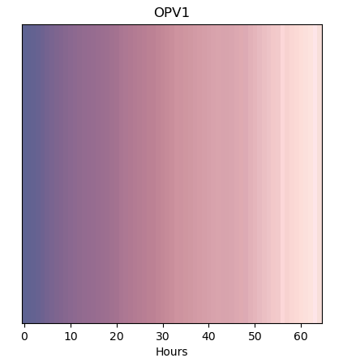
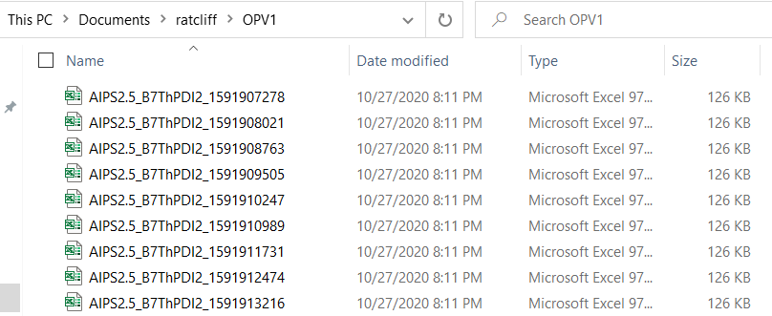
Running Colorlab
The program assumes that the file names of the UV-Vis data contain a timestamp within the name. The program uses these time stamps to generate an axis label.
After selecting the “Browse” option, we navigated to Documents/ratcliff/OPV1 where the UV-Vis data lives
Example of an image generated by Colorlab GUI using Illuminant C, and a saturation scalar of 2.

Slide 8
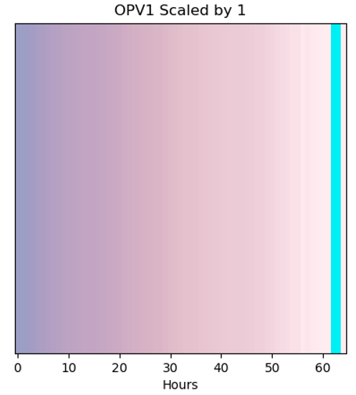
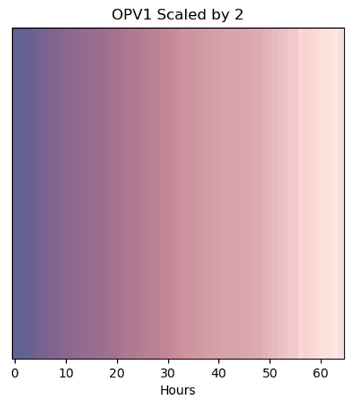
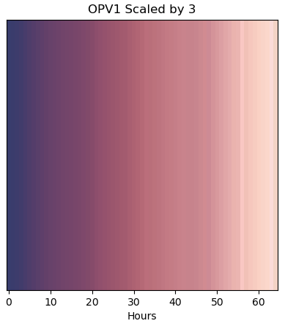
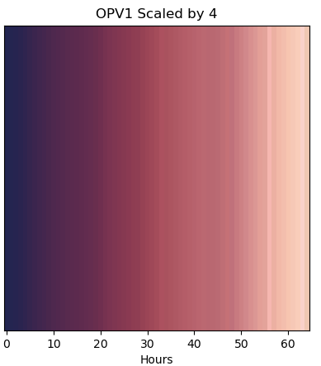
Running Colorlab
Example of an image generated by Colorlab GUI using Illuminant C, and unscaled data (saturation scale of 1). The cyan band is an indication of invalid data that can sometimes be avoided by scaling.
Example of an image generated by Colorlab GUI using Illuminant C, and a saturation scalar of 2.
Example of an image generated by Colorlab GUI using Illuminant C, and a saturation scalar of 3.
Example of an image generated by Colorlab GUI using Illuminant C, and a saturation scalar of 4.

Slide 9
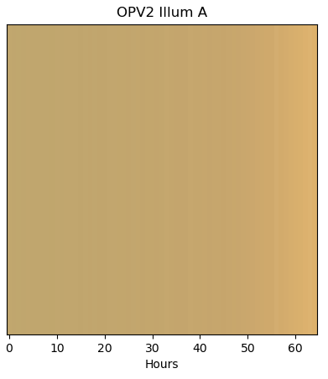
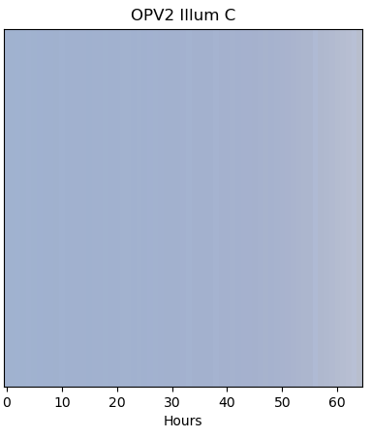
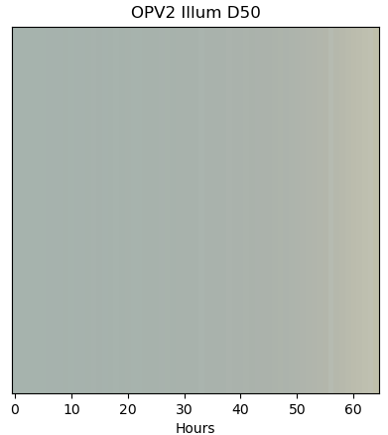
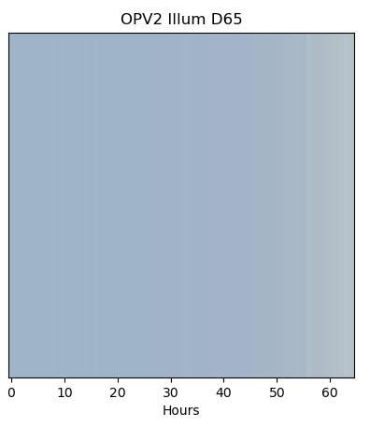
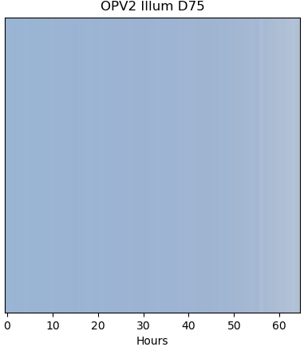
Running Colorlab
Example of images generated by using each of the available illuminants, and a saturation scalar of 1.

Slide 10
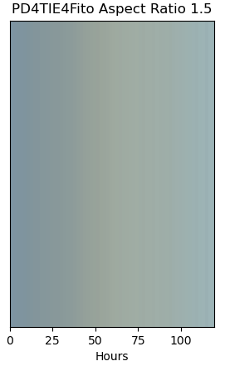
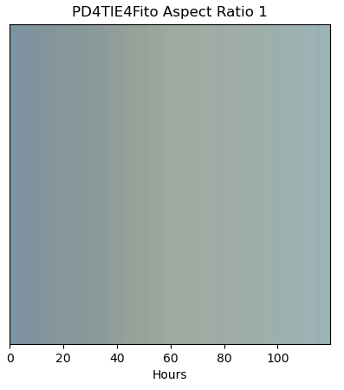
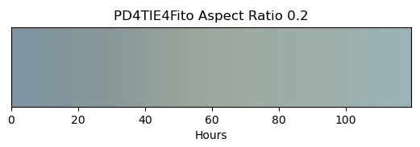
Running Colorlab
Example of images using different aspect ratios, each using Illuminant C and a saturation scalar of 3 (aspect ratio of 1 is the default).

Slide 11
Running Colorlab
The program exclusively uses absortance data to generate the images. Make sure there is a column in your data files with the name “FA (1-FR-FT)”
The program can read Microsoft Excel 97-2003 Worksheets (which have .xls file extensions) or comma separated values files (which have .csv file extensions)
This program will not be supported any further by the Ratcliff Group, so please feel free to make your own adjustments as needed!
Thank You

Slide 12
Information on Illuminants
CIE Standard Illuminant A: Mathematical representation of tungsten halogen (incandescent). Color temperature: 2856K. Can be used to test metamerism. Simulates limited residential and commercial retail lighting.
CIE Standard Illuminant D65: Mathematical representation of average noon sky daylight. Color temperature: 6500K. Uses include general evaluation of color, metamerism testing, providing visual correlation with spectrophotometric instrumental readings, and conformance with global industry standards.
CIE Illuminant D50: Mathematical representation of ‘horizon’ daylight in the early morning or late afternoon. Color temperature: 5000K. Uses include general evaluation of color, metamerism testing, and evaluating color uniformity and quality in the graphic arts industry.
https://www.xrite.com/service-support/understanding_illuminants

Slide 13
Information on Illuminants
CIE Illuminant D75: Mathematical representation of north sky daylight. Color temperature: 7500K. Uses include general evaluation of color, metamerism testing, and visual evaluation of opaque materials as outlined by ASTM D1729. Simulates north sky daylight.
Standard illuminant C: Approximates average daylight with a higher color temperature of 6774 K (due to a relatively stronger contribution of the blue sky).
https://www.xrite.com/service-support/understanding_illuminants

